Slide 1

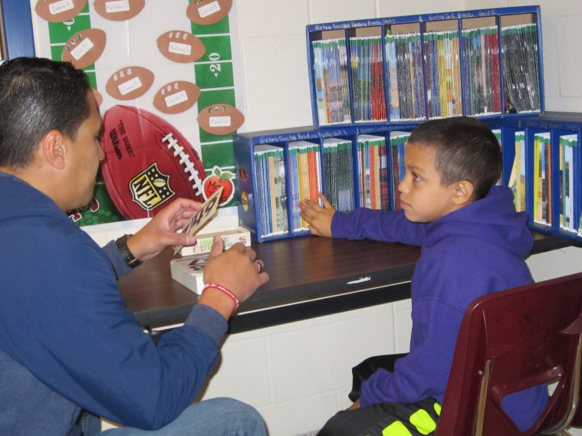
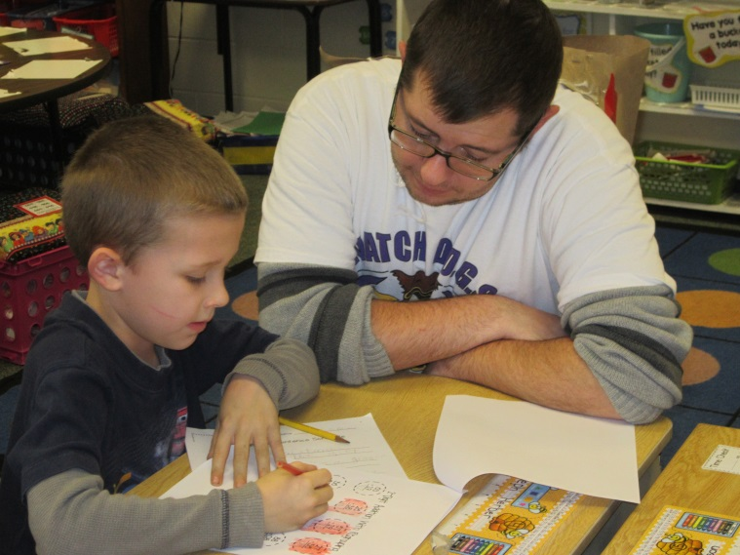
Spring Ridge watch d.o.g.s.

Slide 2
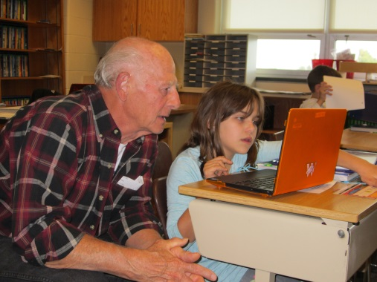
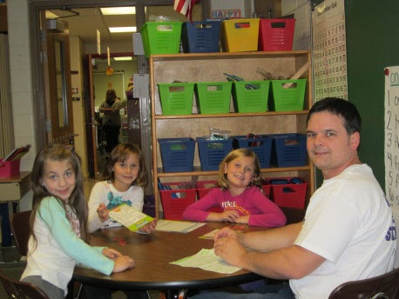
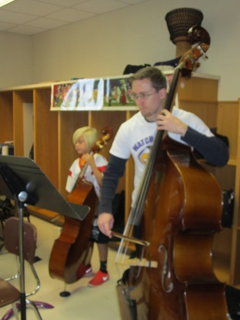
background information
The program began in 1998, and has brought thousands of fathers and father figures into schools across the country.
It was recognized by congress in 2000 as “a great tool in our efforts to prevent school violence and improve student performance because it can increase parental initiative and involvement in their children’s education.”

Slide 3
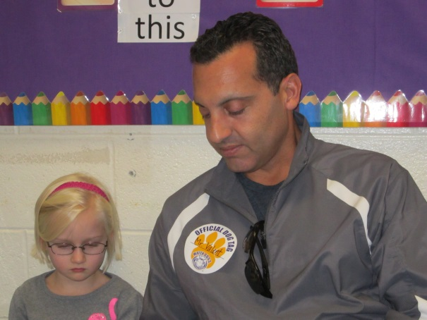
What are Watch D.O.G.S.?
Watch D.O.G.S. are Dads of Great Students!
The Watch D.O.G.S. program is an educational initiative of the National Center for Fathering.
The two primary goals of the program are:
To provide positive male role models who, by their very presence, show a respect for the importance of education.
To enhance school security and
reduce bullying.

Slide 4
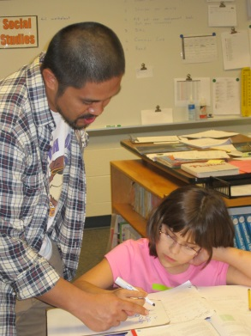
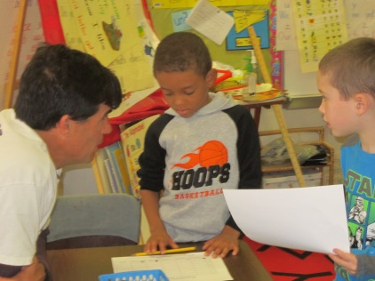
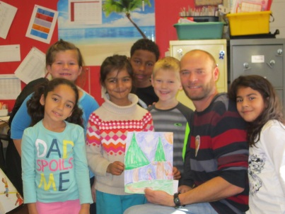
A win-win-win situation
The three winners are:
Children of the D.O.G.S. and other children at our school love spending time with all the dads. The children feel important and thrive on the extra attention dads give to them.
Dads get an inside look into their children’s school day.
Teachers appreciate the support dads give to all of the students at Spring Ridge!

Slide 5
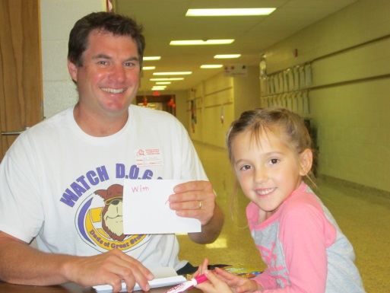
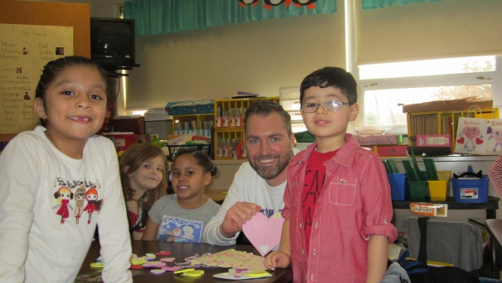
Our goal for your daY
You’ll help out during lunch/recess, special class, and one content area with your child/children.
You’ll be productive throughout your day – not merely observing but working with the children one-on-one, in small groups or with the entire class.
You’ll enjoy your time here and want to come back again and again!

Slide 6
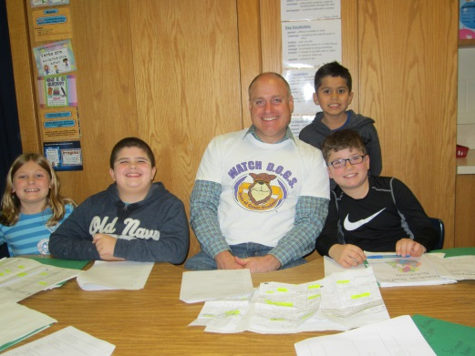
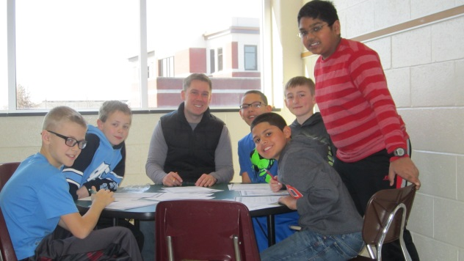
A Sample SchedulE
8:20 – 8:35 – Sign In, Packet and Photo
8:35 – 9:00 – Spring Vision and Greet Children
9:00 – 9:40 – Fourth Grade
9:40 – 10:20 – Kindergarten Action Based Learning
10:20 – 11:10 – Third Grade
11:00 – 11:15 – Watch Dog Break
11:15 – 11:55 – Fifth Grade
11:55 – 12:35 – Lunches and Recesses
12:35 – 1:15 - Special (Music, Art, Library, Phys. Ed., Discovery, Social Citizenship, Guidance)
1:15 – 1:55 – Life Skills Classroom
1:55 – 2:35 – Second Grade
2:35 – 3:15 – Third Grade
3:15 – Survey in Guidance Office

Slide 7
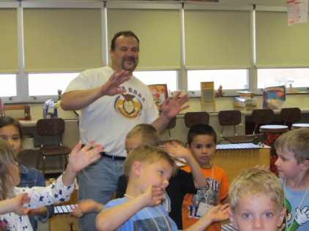
Watch D.O.G.S. do . . .
Smile and encourage children.
Monitor hallways and grounds.
Play and/or referee during recess.
Eat lunch and talk with children.
Respect and maintain confidentiality.
Report any concerning behavior.
Wear official Watch D.O.G.S. shirt
and/or nametag.
Get to be a rock star for the day!

Slide 8
Watch D.O.G.S. do not . . .
Work with students alone or unsupervised.
Use student restrooms.
Engage in any conduct that could bring disrespect to themselves or to children.
Discuss politics or religion.
Handle difficult situations on their own.
Discipline children.

Slide 9
Clearances
You’ll need Child Abuse History and Criminal Background History clearances (free for school volunteers/online and paper applications). If you haven’t lived in PA for the past ten years, you’ll also need an FBI Background Check.
Clearances must be dated from the beginning of this school year and are good for five years.
Bring originals to school. We’ll make copies.
Child abuse, Criminal, FBI (in order):
http://www.compass.state.pa.us/cwis/public/home
https://epatch.state.pa.us/TandCVolunteerAction.do
https://www.pa.cogentid.com/index_pdeNew.htm

Slide 10
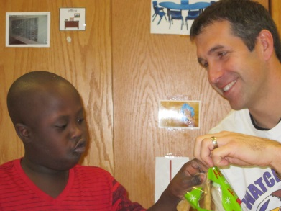
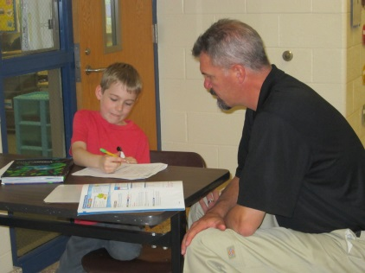
Before choosing a date, consider . . .
Does the WSD have your clearances? If not, please pick a date later in the school year.
Do you want to join us on a special day, such as a child’s birthday? Look for that date or one close to it.
Would you like to be a Watch D.O.G. more than once this year? That’s no problem – just sign up for a few dates.
If possible, please sign up for dates at least a week out, to us give time to create a schedule.

Slide 11
Time to pick a date!
http://www.signup.com/go/T7guvE
The address is case sensitive.
Type email address twice.
Click on preferred date.
Click sign up.
Type name and phone number.
Check receive updates . . .
Click save.
Click save at bottom of the sign up page.
Thank you for being
a Watch D.O.G.!

